Slide 1






Blockchain Education for Aetna
Presenters:
Jin VanStee
Austin Grice
Barry Silliman
Special Thanks To:
Dave Wakeman
Daniel Acosta
Kevin Lee

Slide 2
2-Day Education Agenda
Day 1
Blockchain Explained
Blockchain Solutioned
Demo of IMMUNIChain
Day 2
Blockchain Composed
Composer Lab using IMMUNIChain
Notes:
Our goal over the next two days is to provide you with an introduction to blockchain, as well as take a look at the tooling available to design and test out a blockchain use case. At the end of the two day education, you will have knowledge to articulate why blockchain is valuable in today’s world, and you will gain insight into how you can begin to design your own blockchain business network. Right in time for your Innovation Tournament.
Day 1 is focused on providing a high level introduction to blockchain concepts and its business value, and we will also be providing solution examples in the Insurance and Healthcare industry. It is very important to understand the value of blockchain and its four tenants (consensus, provenance, immutability, and finality), they should be on top of mind as you are developing uses cases for the Innovation Tournament.
Day 2 is focused on applying the concepts learned in Day 1 into actually creating a blockchain business network using open source tooling available only with Hyperledger Project. You will have the opportunity to try a one of a kind lab to get familiarized with the tool which will also help solidify the concepts from Day 1.

Slide 3



Blockchain Explained
An Introduction to Blockchain for Business
Blockchain education series
Explained
Solutions
Composed
Next Steps
V5.0
V5.0, 23 August 2017
Notes:
There is much hype around Blockchain. Most of this relates to the use of Blockchain to underpin the Bitcoin cryptocurrency. When Paris Hilton tweets about an ICO (initial coin offering), perhaps it’s overly hyped. Whilst IBM is not interested in cryptocurrency, we are very interested in exploring the broader business application of blockchain technology. This is a transformational opportunity for many of our clients.
IBM is a recognized leader in making blockchain real for business. We are helping many hundreds of clients on their blockchain journeys.
This presentation is the first step! IBM has lots of educational material (signified by the breadcrumb trail at the top of this chart) and a well-defined engagement process that will help. We will take you through all of this later on in this presentation.

Slide 4

Contents
What is Blockchain?
Why is it relevant for our business?
How can IBM help us apply blockchain?

Slide 5
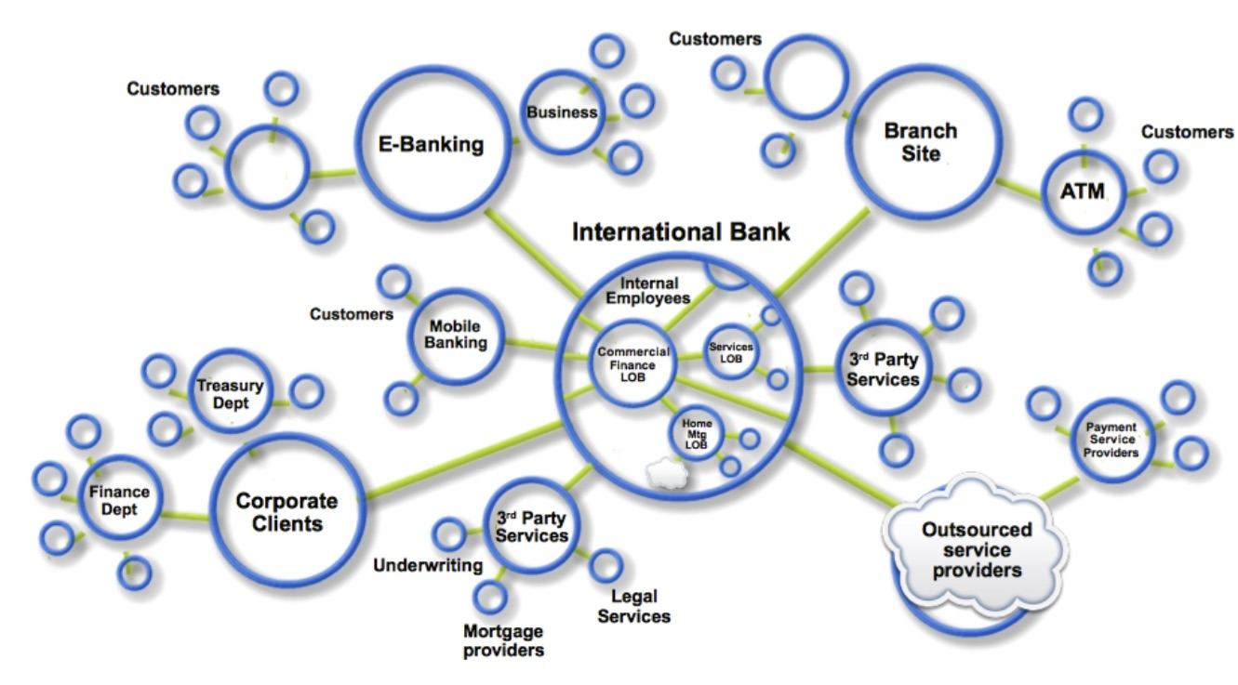
Business networks, wealth and markets
Business Networks benefit from connectivity
Participants are customers, suppliers, banks, partners
Cross geography & regulatory boundary
Wealth is generated by the flow of goods & services across business network in transactions and contracts
Markets are central to this process:
Public (fruit market, car auction), or
Private (supply chain financing, bonds)
Notes:
We observed that businesses never operate in isolation. They always work together with other businesses, with governments, with banks, with all different types of organizations within markets.
And effectively, wealth is generated by the flow of goods and services across these business networks. And markets could actually also be of two different types. We could actually have an open market, such as an auction, or a private market, such as things like a supply chain financing or bonds exchange. So effectively, these business networks are fundamental to the application of Blockchain, as I’ll come and describe as we go through the rest of the presentation.
Business never operates in isolation. They are participants in a business network.
Business Networks will connect customers, suppliers, banks and regulators and will cross geographical boundaries.
WEALTH is generated or transferred as goods and services move across this network; this flow is referred to as a MARKET.
Growth of wealth can be constrained if the network is heavily silo’d or inefficient.

Slide 6
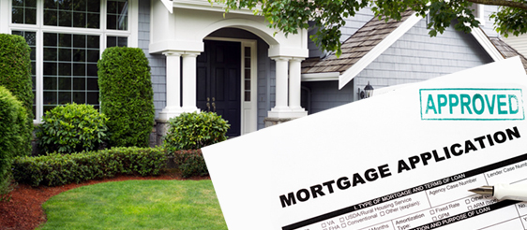


Transferring assets, building value
Anything that is capable of being owned or controlled to produce value, is an asset
Two fundamental types of asset | Intangible assets subdivide | Cash is also an asset
Tangible, e.g. a house Intangible, e.g. a mortgage | Financial, e.g. bond Intellectual, e.g. patents Digital, e.g. music | Has property of anonymity
Notes:
Assets are fundamental to business networks and thus to blockchain applications. Assets are transferred across the business network and we also observed that assets are of two different types, fundamentally. There are tangible assets, like your house or your car, and there are intangible assets, like a piece of digital music or a financial instrument such as a bond, or a piece of intellectual property. These would be examples of intangible assets. And we also observed on the right-hand side of the screen, that cash is also an asset, which has the interesting property of anonymity. Effectively, I don’t know if I’m given a 5 dollar bill, where that 5 dollar bill came from and also where it’s going to go to after I’ve owned it.
Ownership of assets pass across the network in return for payments, and governed by contracts.
ASSETS can be tangible and intangible, We are most comfortable with tangible (Cars, Houses),
INTANGIBLE assets – financial instruments most obvious, but don’t forget about intellectual assets like patents and growing digital assets (music, games, video, art).

Slide 7
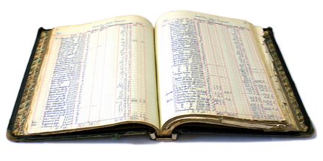
Ledgers are key
Ledger is THE system of record for a business.
Business will have multiple ledgers for multiple business networks in which they participate.
Transaction – an asset transfer onto or off the ledger
John gives a car to Anthony (simple)
Contract – conditions for transaction to occur
If Anthony pays John money, then car passes from John to Anthony (simple)
If car won't start, funds do not pass to John (as decided by third party arbitrator) (more complex)
Notes:
Ledgers are not new – they have been used for double entry book keeping since the 1494 when Luca Pacioli (the Franciscan monk) created double-entry book-keeping.
Commercial usage of the term is for the "principal book of account" in a business house.
THE system of record for recording asset transfer in and out of a business.

Slide 8

Introducing Blockchain ...
A trusted, distributed ledger
with shared business processes
Blockchain
© 2017 IBM Corporation
Notes:
Now, we haven’t talked about Blockchain very much up to now. Let’s actually bring Blockchain into the picture. Blockchain at the very highest level is a trusted distributed ledger which has a shared set of business processes across all the members of the business
network.
What’s new here is the SHARED LEDGER – up to this point each participant had their own Ledger
This sharing is the foundation for innovative business solutions,
This introduces an interesting set of technical challenges, including (1) participant identity and privacy & (2) transaction privacy
Let’s look at this in some more detail.

Slide 9


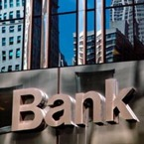




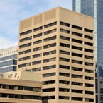
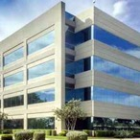



Problem …
Participant B’s records
Participant A’s records
Bank records
Insurer records
Regulator records
Auditor records
… inefficient, expensive, vulnerable
Notes:
So let’s step back for a moment and look at how things operate today. Effectively, every member of the business networkhas their own copy of the ledger, and we’re showing this here at different colors around the different members of the business network. And as I mentioned previously, the ledger is updated every time an asset flows into the organization or goes out of the organization. Each member of the business network who’s affected, updates their ledger.
This system’s been around since the 13th Century. Effectively we’ve been incrementally digitizing a system that’s basically centuries old. The good side of that is it’s pretty well tried and tested and it’s in popular usage. The downside of it is it’s inefficient, it’s expensive, and it’s vulnerable. Now what do I mean by that? Inefficient means that each of the different parties in the business network need to run their own form of the business process to update their ledger. Effectively, they’re doing that in a duplicative way. It’s expensive, in that if you are to do things like internal and external audit, it takes an awful lot of time and effort to do that across the business network.
Some companies have told us that some 20, 2-0, percent of their time is actually spent in the internal and external audit function, because it’s so complicated across the business network. And it’s also vulnerable. It’s vulnerable to either flawed,
malicious modification of the ledger, or to cyber attack or cyber incident; or simple mistakes are actually very difficult to render, should they get into the business network. So as I say, this is before Blockchain comes along…
This is the “BEFORE” picture representing the “status quo” for business networks.
Each participant keeps their own ledger(s) which are updated to represent business transactions as they occur.
This is EXPENSIVE due to duplication of effort and intermediaries adding margin for services.
It is clearly INEFFICIENT, as the business conditions – the contract – is duplicated by every network participant
It is also VULNERABLE because if a central system (e.g. Bank) is compromised due to an incidents this affects the whole business network. Incidents can include fraud, cyber attack or a simple mistake.

Slide 10
A shared, replicated, permissioned ledger …
Participant B’s records
Participant A’s records
Bank records
Blockchain
Insurer records
Regulator records
Auditor records
… with consensus, provenance, immutability and finality
Notes:
If we bring Blockchain into the picture, we have the situation where all of the members of the business network share a common ledger on the Blockchain, and the ledger is replicated through peer-to-peer replication technologies across all the differentmembers of this business network. But we actually use privacy services to determine who can see what on the business network. So for example, if participant A was actually exchanging an asset with participant B, each of these members would be able to see the full details of that transaction. However, the bank, if it was not involved in that transaction, wouldn’t be able to see the details.
Alternatively, if participant A was transferring something with the bank, those two counterparties will be able to see the full details of the transaction and participant B wouldn’t. This is all controlled, as I say, by privacy services.
When we overlay Blockchain onto this network, we end up with these really four important points at the bottom of the slide. Consensus means that we determine who within the business networkgets to validate or approve a transaction. This is encoded into the Blockchain system. We actually engender through the use of Blockchain the concept of provenance. Now this is effectively an audit trail, a complete record of who’s owned what asset throughout its lifecycle. This is all recorded on the Blockchain. And again, because we use privacy services to link one block in the Blockchain with the next block,this means that it’s impossible to tamper with the blocks, once they’re actually written, which gives us a property of immutability, thus, effectively, boosting trust across the business network. And the final thing is, last but not least, it’s finality. And this comes really as a consequence of all the previous three, and it means that once something is committed into the Blockchain, we’ve got one single system of record, one single system of truth across the business network, which can effectively assurethat disputes are very easy to resolve, should they occur.
The novel Blockchain architecture give participants the ability to share a ledger which is updated every time a transaction occurs through peer to peer replication.
Cryptography is used to ensure that network participants see only the parts of the ledger that are relevant to them, and that transactions are secure, authenticated and verifiable.
Blockchain also allows the contract for asset transfer to be embedded in the transaction database determining the conditions under which the transaction can occur.
Network participants agree how transactions are verified through consensus or similar mechanisms. Government oversight, compliance & audit can be part of the same network.
Participants SAME AS BEFORE
CONSENSUS– means all participants agree that a transaction is valid
PROVENANCE– means participants know where the asset came from and how it’s ownership has changed over time
IMMUTABILITY– means no participant can tamper with a transaction once it’s agreed. If a transaction was in error then a NEW transaction must be used to reverse the error, with both visible
FINALITY– means that there is ONE place to determine the ownership of an asset or completion of a transaction. This is the role of the SHARED LEDGER.

Slide 11


Blockchain underpins Bitcoin
is:
An unregulated shadow-currency
The first blockchain application
Resource intensive
Blockchain for business differs in key areas:
Identity over anonymity
Selective endorsement over proof of work
Assets over cryptocurrency
Notes:
When we actually started on this Blockchain journey, we found that a number of people we talked to got very confused between Blockchain and Bitcoin. And we put --hence, putting this slide together. Being really very up front about it, Bitcoin is an unregulated shadow currency, which has the interesting property of anonymity. We don’t know who we’re passing a Bitcoin to and we don’t know who we’re receiving a Bitcoin from. And also, to achieve that anonymity, it’s very compute and resource intensive to
actually make the Bitcoin network work. However, it is the biggest, the first live use of Blockchain in action. Bitcoin’s actually a very
Important reference point. But we’re really interested not in these sense –resistant shadow currencies, we’re interested in Blockchain for business. And this differs from Bitcoin in three really, really important areas. The first is, we prioritize identity over anonymity. This means that everyone in the business network knows who they’re dealing with. So it’s actually very clear who our counterparties are. Second, we prioritize selective endorsement over proof of work, which means that with the Blockchain that we’re interested in, we get to choose who in the business network validates a particular transaction. And this is much, much more computationally efficient than the resource-intensive proof of work that’s associated with Bitcoin.
And finally, we’re actually looking at a very, very broad set of assets and not cryptocurrency. There’s a really interesting paper around, if people are interested in the different types of digital currency and the difference of digital currency from cryptocurrency,
there’s a really interesting paper that if you look in the speaker notes to this presentation, will actually be very clear and you can actually get a link to it. So I hope this explains the difference between Bitcoin and the Blockchain for business.
Blockchain technology enables the Bitcoin crypto currency and is best known for this usage.
However, the shared ledger technology is separate & separable – applicable to a whole range of business challenges that cross all industries.
IBM is not interested in crypto currency, but is missioned to help our customers make the most from Blockchain technologies. We see this as a major transformation opportunity for many of our customers.
Digital currencies (i.e. the representation of FIAT currency as an asset on a blockchain) are auditable and permissioned, hence excellent Blockchain use case
Excellent document from IMF on different (digital) currencies [can be used to close down discussions] > https://www.imf.org/external/pubs/ft/sdn/2016/sdn1603.pdf

Slide 12
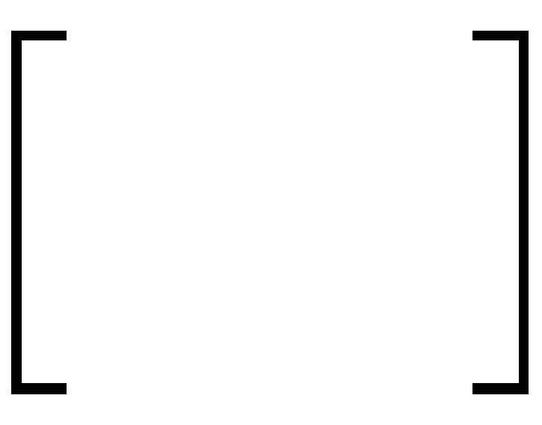

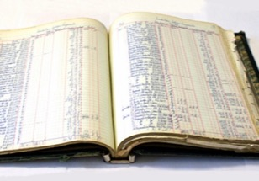
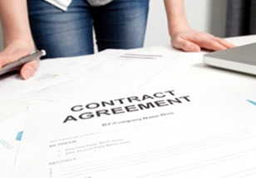




Requirements of blockchain for business
Shared ledger
Smart
contract
Append-only distributed system of record shared across business network
Business terms embedded in transaction database & executed with transactions
Ensuring appropriate visibility; transactions are secure, authenticated & verifiable
Transactions are endorsed by relevant participants
Privacy
Trust
Notes:
Now looking at Blockchain for business, there are four really important blocks that actually – or components that form Blockchain for business. The first we’ve talked a lot about, the shared ledger. This is effectively a way –an append-only distributed system of record that’s used across the business network, shared across the business network. We’ve also talked a couple –on a couple of instances about privacy services, and we talked about how privacy services control who can see what across a business network and also how privacy services are used to maintain this property of immutability across the Blockchain. We’ve also talked indirectly about trust. We’ve actually talked about the fact that because the transactions are endorsed by selected members of the business
network, that this has the effect of increasing the net trust within the business network, and also the fact that each member of the business network knows that they’re sharing a common business process with the rest of the network also boosts trust.
And the way that the business flow or the business logic is actually embedded in the Blockchain, is in the form of a smart contract. Effectively, a smart contract is taking the terms of a traditional contract and coding them up in the form of shared business process and sharing them around this business network. So those are the four fundamental components of Blockchain.
So Blockchain technology comprises these four main blocks, that can lead to increased efficiencies, and cost reduction across the business network.
We will “unpack” CONSENSUS PRIVACY & SMART CONTRACT in the next couple of slides.
Shared LEDGER has been already covered, and a SMART CONTRACT enables the business rules implied by the contract to be embedded in the Blockchain and executed with the transaction

Slide 13

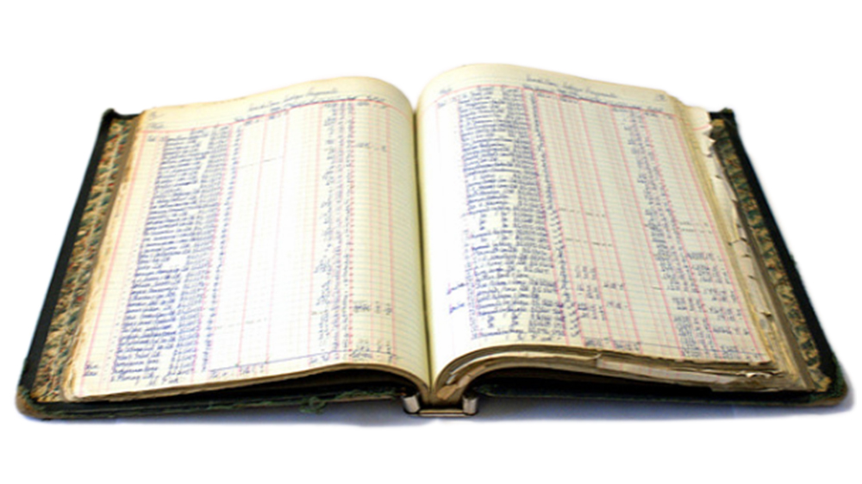
Records all transactions across business network
Shared ledger
Shared between participants
Participants have own copy through replication
Permissioned, so participants see only appropriate transactions
THE shared system of record
13
13
Notes:
What I’m going to do in the next few slides is very quickly go through those in a little bit more detail. I think I’ve probably covered them to a degree, so we can probably quite quickly go these slides. If we look at the shared ledger to start with, we’ve actually – I think I’ve covered already, that the shared ledger records what assets have transferred around the business network. All the participants in the business network have their own copy of this distributed ledger. But we have a session, a concept of permissioning in the Blockchain network, so we can actually control who can see what parts of the ledger. And it becomes the shared system of record across the business network, again, with the net benefit of increasingthe trust within that network.
The ledger is the first “thing” that constitutes blockchain. The is an append-only system of record that has appropriate privacy and permissions.
It is a modernization of the ledger concept that has been around for ages. Crucially the ledger is now shared among the participants of the business network.

Slide 14
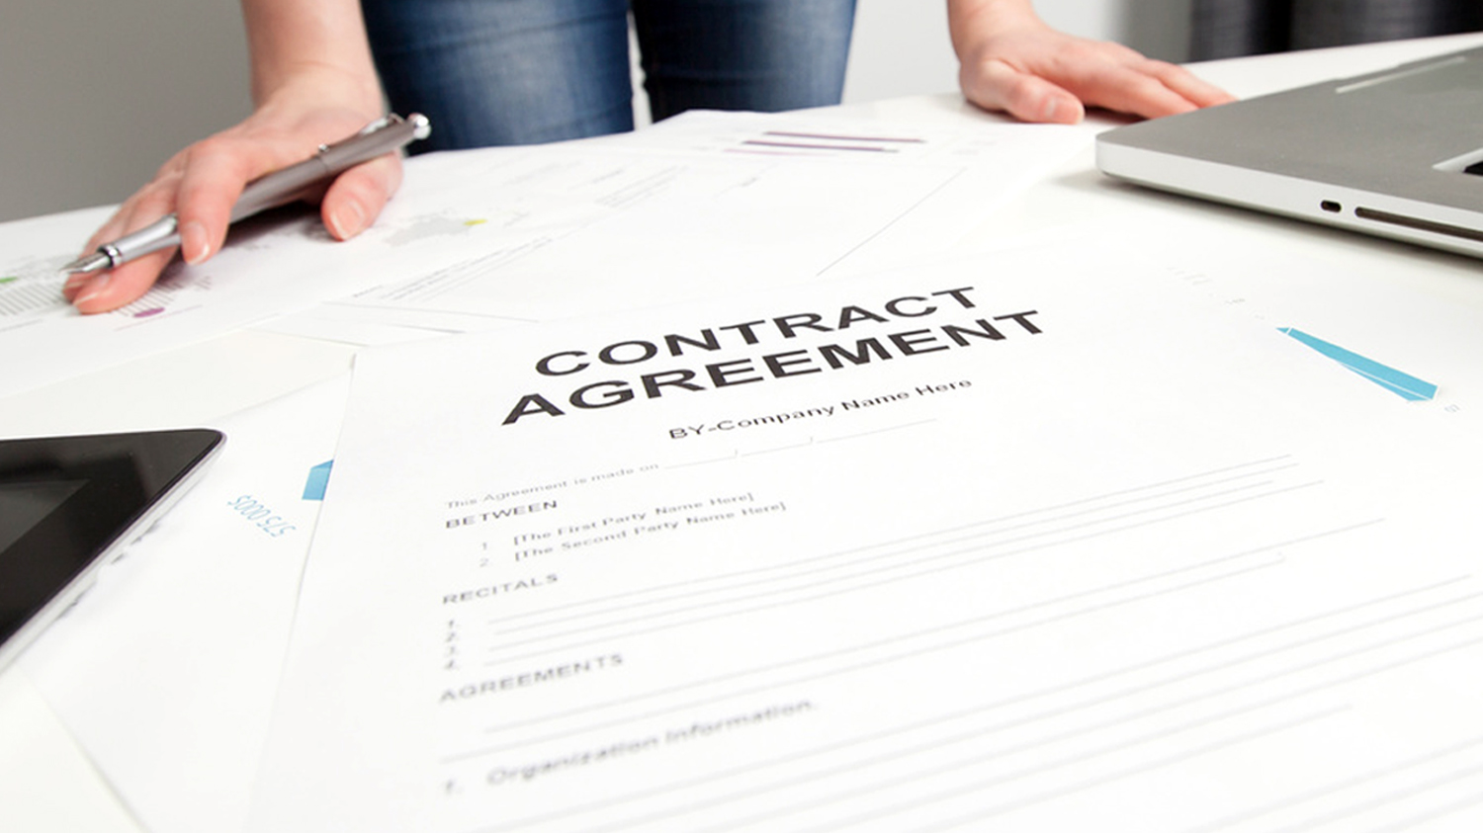
Business rules associated with the transaction
Smart contract
Verifiable, signed
Encoded in programming language
Example:
Defines contractual conditions under which a bond transfer occurs
14
14
14
Notes:
We’ve mentioned up to now smart contracts. Smart contracts are the way of encoding and sharing the shared business process around the business network. The contracts themselves are – the smart contracts are produced by taking the English contract and coding that in computer readable language. And the contracts will also be verified and signed when they’re distributed across the
business network. And the interesting aspect of them, and this really takes organizations a little while to realize once we start talking to them about it, is that once the smart contract is verified and distributed across the business network, it will execute --when the conditions are met, the contract will execute. So there’s no concept of reneging on a smart contract. Once it’s out there, it will happen.
The smart contract is the second “thing” associated with blockchain and describes the rules that govern a transaction.
To a technical audience, a transaction is analogous to a stored procedure call on a database. The smart contract is simply a piece of code that runs; the input parameters to the code (and a reference to the code itself) are stored as the transaction details.
In Hyperledger Fabric the smart contract is implemented as “chain code”.

Slide 15

The ledger is shared, but participants require privacy
Privacy
Participants need:
Appropriate confidentiality between subsets of participants
Identity not linked to a transaction
Transactions need to be authenticated
Cryptography central to these processes
15
Notes:
We’ve talked about privacy quite a lot, but just recapping on privacy services. This really means that it’s a way of controlling the confidentiality within the Blockchain, making sure that people can only see the parts of the distributed ledger that are relevant to them and their way of doing business. And it also means that – it gives us a way of actually making sure that blocks in Blockchain are tied together in a mutable fashion, so the Blockchain becomes tamper proof. So really, privacy services are core to the whole concept of Blockchain for business.
Not every member of business network can see all of the Blockchain
Cryptography controls who can see what
Implies user registration process to build trust network and access permission via certification management

Slide 16

The ledger is a trusted source of information
Trust
Participants endorse transactions
Business network decides who will endorse transactions
Endorsed transactions are added to the ledger with appropriate confidentiality
Assets have a verifiable audit trail
Transactions cannot be modified, inserted or deleted
Achieved through consensus, provenance, immutability and finality
16
Notes:
And finally, trust. Trust is a really interesting concept and it really does need a little bit of thinking about. But effectively, the way we do this in Blockchain for business is, selected members from the business network endorse or validate the particular transaction that occurs and we decide that on a transaction -by-transaction basis. And then once the transactions are endorsed, they will actually be added to the Blockchain. But this gives us a concept of actually having a verifiable audit trail of everything who’s owned what across the business network, from the time it was created and put onto the Blockchain. And this is achieved through these four terms of consensus, provenance, immutability, and finality that I mentioned earlier on in the presentation. We’ll learn a lot about trust and how we actually do that and make it real as we go through the subsequent modules in this use stream series, where we’re going to drill down to a lot of these concepts in a lot more detail.
CRYPTOGRAPHIC consensus needed to support participant anonymity – this is NO TRUST system
This is expensive, giving a COST to anonymity.
When there is TRUST in a business network this become less, in the limit superfluous
So as TRUST increases then cost of consensus decreases or in the limit can be eliminated

Slide 17
Contents
What is Blockchain?
Why is it relevant for our business?
How can IBM help us apply blockchain?

Slide 18

Blockchain is creating extraordinary opportunities for businesses to come together in new ways
Create New Value
Exploit new business models and eliminate inefficiencies
Optimize Ecosystems
Streamline business processes and the exchange of value along your ecosystem
Reduce Risk
Replace uncertainty with transparency and a trusted decentralized ledger
© 2017 IBM Corporation
Notes:
In today's digitally networked world, no single institution works in isolation.
There is a race to capture the tremendous opportunities to create new value, transform industries, optimize business ecosystems, and reduce risk using business networks created with blockchain technology.
With blockchain, inefficiencies in business to business processes created by lack of trust and transparency can now be eliminated and new innovative business processes can be created, streamlining the exchange of value along your ecosystem in ways.

Slide 19

IBM Blockchain
Example: Shared reference data
Benefits
Consolidated, consistent dataset reduces errors Near real-time access to reference data Naturally supports code editing and code transfers between participants
What | Competitors/collaborators in a business network need to share reference data, e.g. bank routing codes, medical codes Each member maintains their own codes, and forwards changes to a central authority for collection and distribution An information subset can be owned by organizations
How | Each participant maintains their own codes within a Blockchain network Blockchain creates single view of entire dataset
Notes:
Now the example that we have put in here are the concepts of bank routing codes. In the US there are nine numbers that decide where your bank payment payments gets routed and there are unique identifiers for the destination bank. This is an example of a shared reference data, but it could be anything. Different business networks can have different examples of reference data. In the health field it could be medical codes. And effectively, right now, all the different members of the business network will keep their own copy of the reference data and that will be updated according to some maybe e-mail or possibly paper trail, which is used to update that information when it changes. By putting all the information on Blockchain, we can actually control who can change the data and who can actually get access to the data once it has been changed, hence, making the whole thing much more reliable, much more online much more real- time. And when you have got a business networkthat maybe spreads across different industries, across different countries, across different regulatory boundaries, this can be a very, very efficient way of actually managing reference data.
The benefits that we see accrued on the right-hand side, effectively reducing errors, improving real-time access to the critical data and supporting natural workflows around creation, modification and dilution of the elements of the reference data. So a very powerful use case. It might seem relatively straightforward, but –and indeed it is. It is quite a good work for organizations to start with, or business Networks to start with, and we have talked about variations of this use case with many different customers up to now.
Any reference data that is shared in a business network is a potential blockchain network.
Think bank routing codes or common vocabularies for asset exchange data (medical codes), where it’s important to be able to make changes to the data set in real time (and without requiring a trusted third party).
Also claim or identity information as required for fraud prevention in insurance networks.

Slide 20
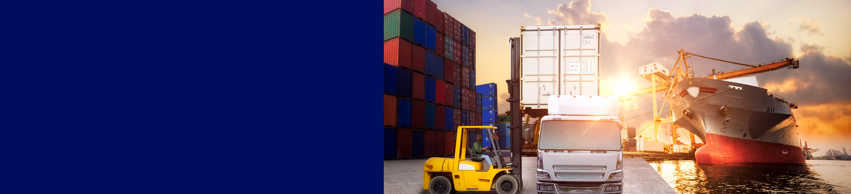
IBM Blockchain
Example: Supply chain
Benefits
Trust increased, no authority "owns” provenance Improvement in system utilization Recalls "specific" rather than cross fleet
What | Provenance of each component part in complex system hard to track Manufacturer, production date, batch and even the manufacturing machine program
How | Blockchain holds complete provenance details of each component part Accessible by each manufacturer in the production process, the aircraft owners, maintainers and government regulators
Notes:
The second one up here is probably the number one cross-industry use case for Blockchain, the supply chain. And we’re showing here the concepts of putting the complex tree of parts for an aircraft onto a Blockchain and using the Blockchain to record when things change in the assembly or disassembly of that tree of parts. And we can record things like all the manufacturing data, where the elements – where the part or the sub system has been in its journey from manufacturer, all the way through to integration and to a final aircraft, and we can even keep things down to which the individual computerated(?) machine programming module that was used to create the part, if that’s relevant. So we have got this way of actually maintaining throughout the lifecycle of an asset who is done what to the asset over time. Although this is an example around a complex system of systems, like a modern aircraft, there are some really interesting use cases and public references that we have got around supply chain.
For example, the other ledger corporation has actually worked with IBM to basically put – render mining to diamond retailing, supply chain onto the Blockchain. And they do that to prevent their supply chain pollution. So that means that they can control – they can make sure that there are no false diamonds or synthetic diamonds are blood diamonds or anything like that get into the supply chain. So effectively, the retailer can be sure that the complete audit trail or provenance of the diamond that they’re buying and, hence, increasing the net value of that diamond through the improvement of trust.
There are examples of supply chain use cases across manufacturing industry, across all types of different industries. And as I say, I think this is probably “the” most common cross-industry use case. The advantages are clear, the trust goes up because you know who is done what to each asset as it goes through its lifecycle. We know who’s owned each asset, where it has been in geographical terms and, hence, the whole supply chain becomes much more efficient, in terms of keeping track of who’s owned what.
Talk about ColdChain. Track Vaccines from creation to administration. And attach a sensor device to the vaccines so you know the temperature of the vaccines throughout its lifecycle.
Coming back and finally to this concept of using Blockchain in the supply to maintain a complex system of record, we can be very specific. If something goes wrong with an aircraft, maybe there is a maintenance incident or something similar, we can be very specific in diagnosing that incident or finding which subsystems of which parts were actually –constituted part of the maintenance event, rather than do a whole cross-fleet analysis or a cross-fleet recall, in the case of failure. So this can reduce costs for those terms as well.
Supply chains are a great source of blockchain use-cases. Here are several examples:
Walmart – tracking the provenance of pork in China (reference example)
IBM Global Finance – reducing the cost of disputes with suppliers (reference example)
Everledger – storing the provenance of diamonds on a blockchain to prevent the trade in so-called blood diamonds (reference example)
Bringing together car servicing network with the manufacturer network would allow manufacturers to target car recalls more effectively
Storing the provenance of aircraft components on a blockchain to track servicing and replacement, and to prevent decommissioned components re-entering the supply chain

Slide 21

IBM Blockchain
Example: Audit and compliance
Benefits
Lowers cost of audit and regulatory compliance Provides “seek and find” access to auditors and regulators Changes nature of compliance from passive to active
What | Financial data in a large organization dispersed throughout many divisions and geographies Audit and Compliance needs indelible record of all key transactions over reporting period
How | Blockchain collects transaction records from diverse set of financial systems Append-only and tamperproof qualities create high confidence financial audit trail Privacy features to ensure authorized user access
Notes:
A good first use-case, which is to give an organization complete and consistent access to their own ledger.
Today organizations typically have audit and compliance departments that consolidate ledger information from different departments every so often in order to supply that information to the auditor or regulator. This is slow and the information quickly becomes out of date.
Blockchain allows this process to be automated and provides visibility to an organization's liquidity in real time.
Furthermore, bringing the auditor into this same business network would completely change the nature of audit and compliance, from being a push to the auditor to allowing the auditor to pull the information on demand.

Slide 22


IBM Blockchain
Example: First Party Medical Claims Processing
Benefits
Errors and re-work can be reduced and the accuracy and traceability of claims can be improved Shortens time to bill & receive payment Simplifies audit process
What | The claims process today involves multiple parties, and has the potential for multiple calls, partial payments, disputed coverages, errors in billing, and crossed payment / billing cycles with delinquent bills sent through collection process
How | Capturing and tracking changes to the claims file on a shared ledger, and using smart contracts to confirm the applicable terms and conditions at various processing steps in the claims processing chain.
Notes:
Insured patient visits doctor, confirms coverage and terms (and receives treatment and medicine)
Report of treatment with procedure codes sent to insurance company for review and payment net of negotiated rates and patient co-pay.
Insurance company provides Explanation of benefits to insured
Billing sent to patient by doctor showing details – net or gross depending on patient.
First Party Medical Claim:
Insured seeks treatment for injury (ER visit)
Claim is registered with Insurer (Proof of Claim/Subrogation assignment Documents are currently required, BC might allow this validation point to be eliminated)
Could be a call or internet report as in current state
Could be generated by Medical provider identifying Insurer from Insured’s BC and the ICD-10 coding
Could be based on SC associated with Insured identifying relationship between bill, accident, and availability of 1st party medical coverage
Electronic Billing triggers SC with Insurer to request bill audit services from 3rd party vender
Also initiates a Medical Records Release process and adds the approval to the BC for use (Audit Vendor might need)
Bill Audit vender accesses Insured’s medical records from ER visit
If Insured’s complete medical history is part of the BC this would eliminate costly searches and record retrieval cycle time
Audit vendor posts findings to the insured’s BC with appropriate security/access controls
Insurer reviews/accepts audit findings and SC initiates electronic payment to the provider and EOB to the insured

Slide 23

IBM Blockchain
Example: Healthcare Benefits Accumulator
Benefits
All parties agree to any changes to benefits accumulator Remediation costs eliminated or drastically reduced Much less prone to fraud & mis-use
What | Benefits accumulators are used by insurance providers to track benefits usage by patients against their health plan allotments. Accumulators can be updated from many sources including physicians, hospitals, pharmacies etc. and synchronization issues can happen requiring inefficient remediation. The process is also open to fraud & miss-use. Transaction integrity and data quality issues can drive rework and errors in patient care and benefits tracking.
How | A blockchain mechanism could replace the core enterprise datastore with blockchain instances that could be partitioned by a few dimensions, such as patient account, benefit type, or some other attribute.
Notes:
Summary
Benefits accumulators are used by insurance providers to account for benefits usage by patients in accordance with their plan allotments.
Problem statement
There can be many drivers of accumulator updates, from different plans, providers, and data sources. Synchronization issues can happen requiring error prone remediation. Like other relational systems, transaction integrity, data quality, and overall data quality issues can drive rework and errors in patient care and benefits tracking.
Value proposition
As the accumulator is essentially a ledger based model, the blockchain can record transactions with the qualities of immutability and traceability as the patient consumes benefits. Other systems can engage in transactions and smart contracts for automated interaction and tracking of benefits.
Processes.
The model below shows an accumulator subsystem for an health care payer. There are several operational datastores (ODS) interacting with realtime and batch services. This is where synchronization and other issues arise due to collisions, latency, or other asynchronous dynamics in the surrounding environment which drive accumulator transactions.
A blockchain mechanism could replace the core enterprise datastore with blockchain instances that could be partitioned by a few dimensions, such as patient account, benefit type, or some other attribute. More analysis is needed on what an optimal scheme would be to provide the level of integrity but not waste resources with unnecessary redundancy.
=======================================================================================
Managing claims accumulator data in a timely fashion can be both difficult and costly to a health plan. Accumulators are the method of precisely collecting and calculating total claim dollar values against plan deductibles and benefit limits. Accumulators that are shared between core medical and third party benefits partners such as pharmacy, mental health, dental and vision can result in data that is out of synch. With increased risk of incorrectly paying claims, the numerous hours to reconcile and potential impact to bottom-line results, many plans resort to manual processes to address this problem

Slide 24

IBM Blockchain
Example: Healthcare Payments Prior authorization
Benefits
Speed up time to service Value added services, e.g. suggest alternative better covered services Reduce error, fraud and mis-use Improve patient outcome and experience
What | Prior authorization is the process of determine if and how much of a medical good or procedure is 'covered' based on a patients health records and their insurance coverage. The medical provider, patient and payer are involved in this network, and timely agreed updates are essential for all parties.
How | A blockchain shared ledger contains the patient's entitlement and smart contracts (encoding the pre-authorization conditions) specify the conditions under which this is changed, and by whom. Blockchain simplifies this complicated relationship and automates the information collection and sharing.
Notes:
Prior authorization is a process used by some health insurance companies in the United States to determine if they will cover a prescribed procedure, service, or medication. The process is intended to act as a safety and cost-saving measure, although it has received criticism from physicians for being costly and time-consuming process. If so, a manual process is initiated. The process to obtain prior authorization varies from insurer to insurer, but typically involves the completion and faxing of a prior authorization form. At this point, the medical service may be approved, rejected, or additional information may be requested. If a service is rejected, the healthcare provider may file an appeal based on the provider's medical review process.^{[4][5]} In some cases, an insurer may take up to 30 days to approve a request.^{[6]}
A study in the Journal of the American Board of Family Medicine found that the annual cost per physician to conduct prior authorizations was between $2,161 and $3,430.^{[12]} The cost to health plans has been reported at between $10 and $25 per request.^{[1]} It is estimated that current prior authorization practices cost the US healthcare system between $23 and $31 billion annually

Slide 25
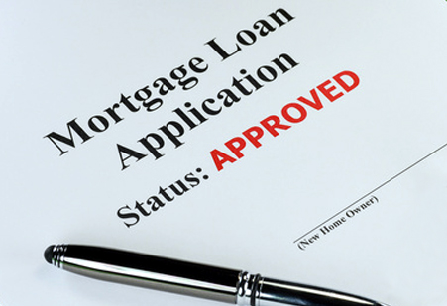
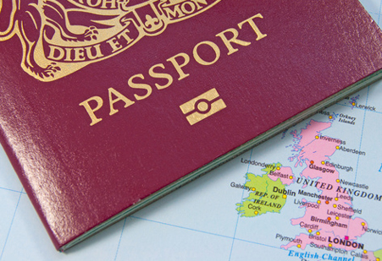


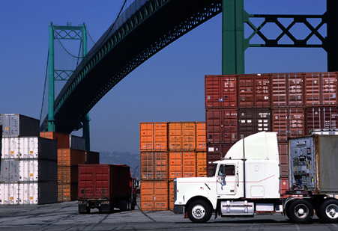
Further examples by (selected) industry
Financial | Public Sector | Retail | Insurance | Manufacturing
Trade Finance Cross currency payments Mortgages | Asset Registration Citizen Identity Medical records Medicine supply chain | Supply chain Loyalty programs Information sharing (supplier – retailer) | Claims processing Risk provenance Asset usage history Claims file | Supply chain Product parts Maintenance tracking
Notes:
So there are examples of these Blockchain use cases really bubbling up in all industries. The finance industry were without a doubt the early adopters of Blockchain technology. A lot of the banks saw Blockchain as both a threat and an opportunity to their business, and started with a number of early experimentations. But we have actually seen all of the different industries embrace Blockchain to some degree or other and start to look for really the positive compelling use cases within their industry. And we effectively come back to these four powerful words of consensus, provenance, immutability and finality. Those are really key, but the fundamental
one is whether a business network exists. So if a business network doesn’t exist, the chances are it isnot a good Blockchain use case. You could really render it with something that’s much more traditional technology, like distributed database.
However, if a business network exists, we then go and look at these four test words to see whether it is a good Blockchain use case.
And we have actually found really good use cases across the different industries.
As I say, finance was the guys who were in there first. The public sector guys found a number of very powerful use cases, very compelling to governments, to effectively reduce bureaucracy while increasing trust on the government-to-citizen transaction. So lots of very powerful use cases in there. The retail organizations also saw a number of different use cases on things like loyalty programs, supply chains are clearly very key to the retail industry, and insurance, again, the whole concept of claims processing, particularly
for complex insurance instruments involving multiple parties. Lots of benefit from putting those onto a Blockchain. And finally, manufacturing, last but not least, again, lots of complicated manufacturing processes with supply chains, which can get great
benefit from actually embracing Blockchain technologies.

Slide 26
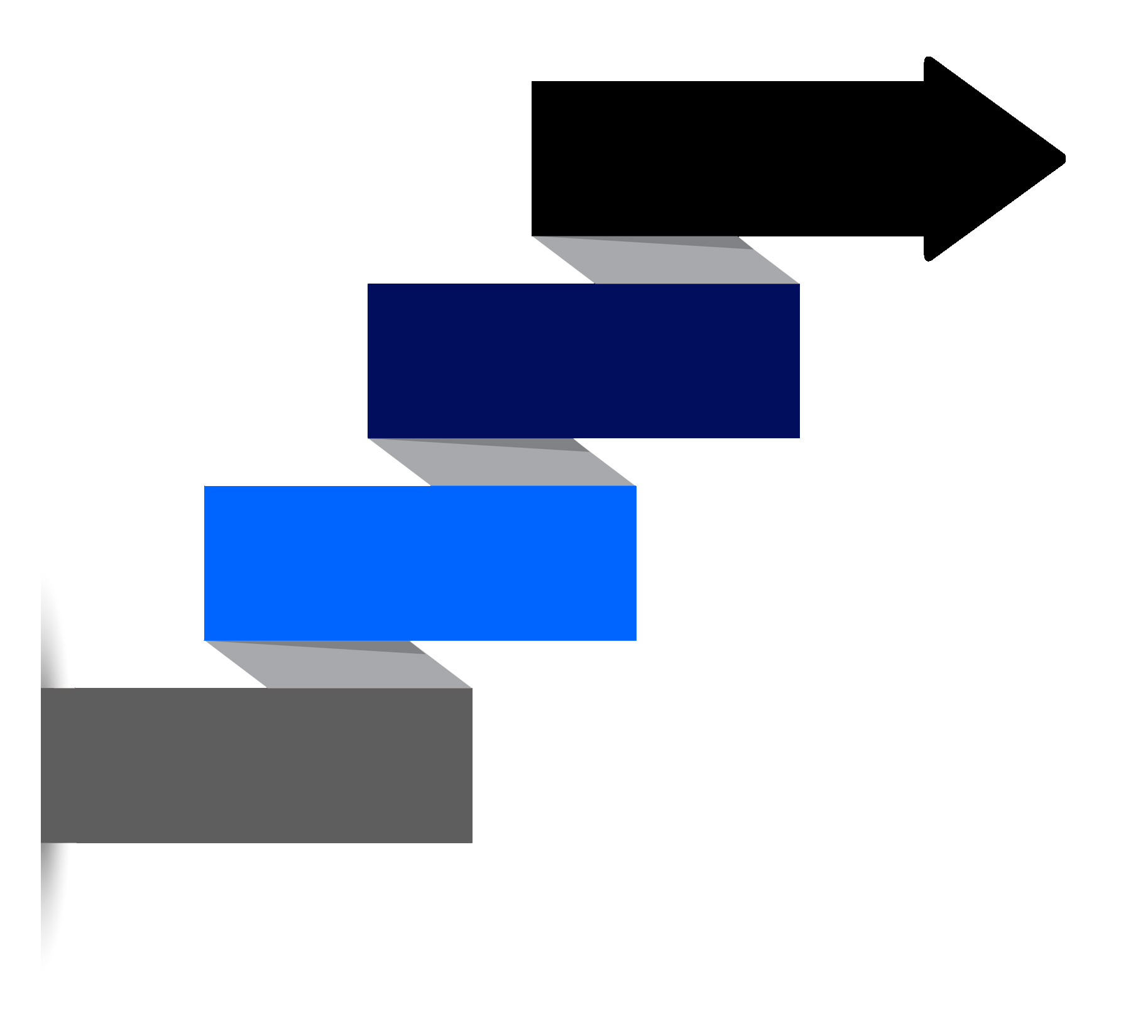
Patterns for customer adoption
HIGH VALUE MARKET
Transfer of high value financial assets
Between many participants in a market
Regulatory timeframes
ASSET EXCHANGE
Sharing of assets (voting, dividend notification)
Assets are information, not financial
Provenance & finality are key
CONSORTIUM SHARED LEDGER
Created by a small set of participants
Share key reference data
Consolidated, consistent real-time view
COMPLIANCE LEDGER
Real-time view of compliance, audit & risk data
Provenance, immutability & finality are key
Transparent access to auditor & regulator
© 2017 IBM Corporation
Notes:
We’re very, very passionate and very, very enthusiastic about Blockchain. But we also must be very cognizant that it still is an emerging technology. Just to give you some concrete numbers around this, last year we did some 85 projects with customers worldwide. This year, in quarter one, we have done some 45, almost 50 projects with customers worldwide. So it gives you an indication. We’re really getting started, we’re in the foothills of this Blockchain journey. And it is really –another thing that our team gets involved in is actually helping people find a good Blockchain First Project use case. Now we encourage them, to look for somewhere that they can start small, improve their awareness in Blockchain technologies and then grow very quickly as they actually learn and adopt. And we have actually put together a hierarchy of different use cases. So it is much easier to start with something on the compliance ledger, and work your way up the stack, than really trying to start higher.
Blockchain use-cases tend to fall into one of these four categories.
The categories towards the bottom of the chart tend to be easier to implement because they have fewer participants to influence, or require less regulatory involvement. This makes them more suited to first projects.
Use-cases in the categories towards the top of the chart may take longer to come to fruition, but are highly valuable/transformative.
And we effectively come back to these four powerful words of consensus, provenance, immutability and finality. Those are really key, but the fundamental one is whether a business network exists. So if a business network doesn’t exist, the chances are it is not a good Blockchain use case. You could really render it with something that’s much more traditional technology, like distributed database.
However, if a business network exists, we then go and look at these four test words to see whether it is a good Blockchain use case.

Slide 27



Key players for blockchain adoption
Regulator | Industry Group | Market Maker
An organization who enforces the rules of play Regulators are keen to support Blockchain based innovations Concern is systemic risk – new technology, distributed data, security | Often funded by members of a business network Provide technical advice on industry trends Encourages best practice by making recommendations to members | In financial markets, takes buy-side and sell-side to provide liquidity More generally, the organization who innovates - Creates a new good or service, and business process (likely) - Creates a new business process for an existing good or service
Notes:
We have also noticed, while we have been on the Blockchain journey, we have noticed some different types of players in the business network. Most of the companies we talked to last year were individual organizations and were saying, hey, this Blockchain technology could be good for us if we use it with core members of our business network. So effectively sponsored by individual organizations and working outward. But this year already we have actually talked to a number of different across industry organizations or within industry
Organizations in multiple companies who want to take onboard Blockchain and use it to make their small business network, or maybe large business network, more efficient.
And we also see within these business networks, different roles for the different parties involved. So clearly the regulator -- could be a national bank in the case of a financial use case for Blockchain--could be sponsoring the growth of the network. A lot of the national banks are experimenting with the use of Blockchain technologies for a number of different things, so they could get the project starte
d. Industry groups. We were actually talking to an industry just a couple weeks ago in the UK who were interested in having a shared common process across their industry, to make thingsmore efficient, in this case, the concept of maintaining or building particular large complex things.
Or indeed, the initiative could be actually started by a market maker, someone who actually wants to really try and push forward the way that the organization works, and the way that a business network works to create new groups and services and to create new value within existing business networks. So we can start with any of these or any combination. And as we say, we have noticed the trend through this year of working with more business networks and while continuing, obviously, to work with individual customers to increase their awareness.
Blockchain use-cases tend to require the influence of one or more external stakeholders, which are described here.
Examples of industry groups are R3 (finance) and B3i (insurance).
An example of a non-financial market maker include Apple, if for example you wanted to create a secondary market for music licenses.

Slide 28
Contents
What is Blockchain?
Why is it relevant for our business?
How can IBM help us apply blockchain?

Slide 29
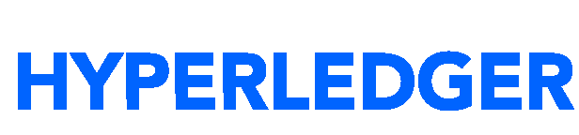
Bringing together the world’s most advanced expertise, technology and ecosystem to transform industries
Experts
Collaborate with comprehensive services teams from ideation all the way to production
Solutions
Solve critical industry challenges by building and joining new business networks
Platform
Develop, govern and operate enterprise blockchain networks with speed and security
IBM
Blockchain
As a founding and premier member of Hyperledger, we’re committed to open source, standards and governance
© 2017 IBM Corporation
Notes:
From Ideation to PoC to Pilot to production quickly develop, deploy and operate on with stability and consistency
Really crossing an important threshold. Open source of aspects of blockchain is maturing rapidly. Hyperledger fabric as a run time has hit a significant 1.0 milestone.
Announcing a production ready service.
The most complete and production ready platform is build around comprised of 3 main lifecycle capabilities meant to (develop blockchain apps and activate blockchain networks at speed and scale. ....simplify, standardize and accelerate blockchain app development, initiation/democratic governance and network operations
developer sandbox in the cloud for rapid iteration and prototyping
having an environment that doesn't take 6months to a year to build on your own and Millions of dollars to basic it plumbing...key management,
complete production ready runtime as well that now includes a set of native governance tools that help solve difficult multi-party problems
24x7 integrated service, production hardened to optimize for performance and resiliency with an architecture that is all automated and instrumented as a modern cloud service

Slide 30
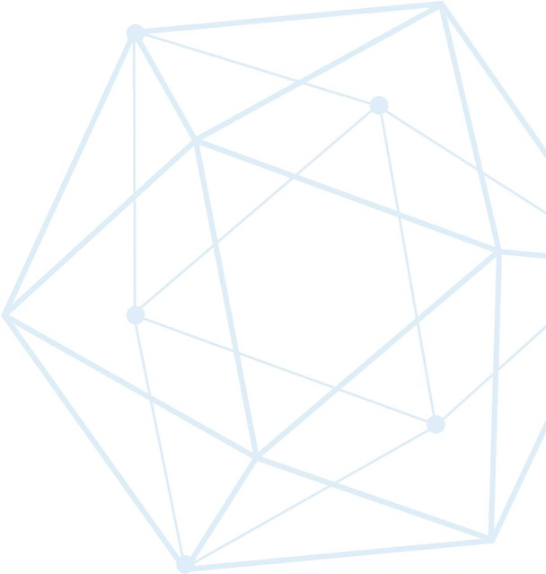



Hyperledger: A Linux Foundation project
A collaborative effort created to advance cross-industry blockchain technologies for business
Announced December 2015, now around 150 members
Open source, open standards, open governance
Five frameworks and three tools projects
IBM is a premier member of Hyperledger
Brian Behlendorf
Executive Director
Blythe Masters
Board Chair
Chris Ferris
TSC Chair
www.hyperledger.org
Notes:
And the final section I’m going to go and talk about for a few minutes about how IBM is getting involved in Blockchain and how IBM is looking to apply Blockchain technologies to improve how our customers work. The way that IBM is involved in Blockchain really are in these three different slices. From a technology point of view, late in 2015, IBM were a founder member of the Linux technology – the Linux Foundation Hyperledger project. And most of our work’s been to contribute to the Hyperledger Fabric part, a sub-project within there. But effectively, we saw this as being the most effective way of growing Blockchain for business. And since then, we’ve also been working on a Hyperledger Composer. And again, I’ll come and mention that in a little bit more detail later. But that’s effectively a way of increasing time-to-value, shortening or speeding up time-to-value on customer project, by allowing us to work a higher level of abstraction than writing the rule chain code that renders a smart contract.
It is important to correctly distinguish between the terms and projects here:
Hyperledger is a trademark of the Linux Foundation and is the umbrella for a group of projects designed to advance blockchain for business.
Hyperledger Fabric is one framework that is underneath this umbrella. Contributors to Fabric include IBM, DTCC, Fujitsu and others. Other frameworks include Iroha and Sawtooth.
IBM Blockchain is used to describe the breadth of technologies and services that are supplied uniquely by IBM (e.g. hosting on Bluemix).
One of the key differentiators for Hyperledger is open governance. This means that there is no one controlling organisation that governs the direction of the project, and no lock-in to one particular vendor. Open governance, which means that all the members of the network decide on the direction that the Blockchain’s fabric is taking. So it’s not locked or directed by any particular industry or member.
This is through common consensus through the different members.
The Blockchain Fabric that’s produced is open source, but more importantly, we use open standards. So we actually see into operability between Blockchains in the fullness of time being really important, hence, our focus on open standards on the way through this.
We’re focusing in on the Fabric project. That’s the one that’s effectively rendering this, if you like, middleware for Blockchain for customers, Blockchain for business. There are other incubators as part of the Linux Foundation Hyperledger umbrella. But our main interest is in the Fabric project. And we’re a premier member of the – of project.

Slide 31
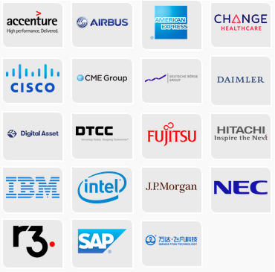
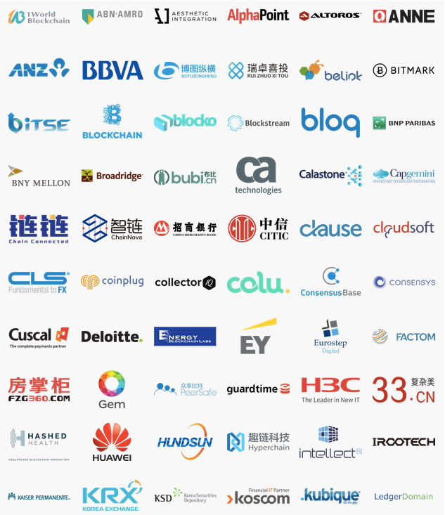
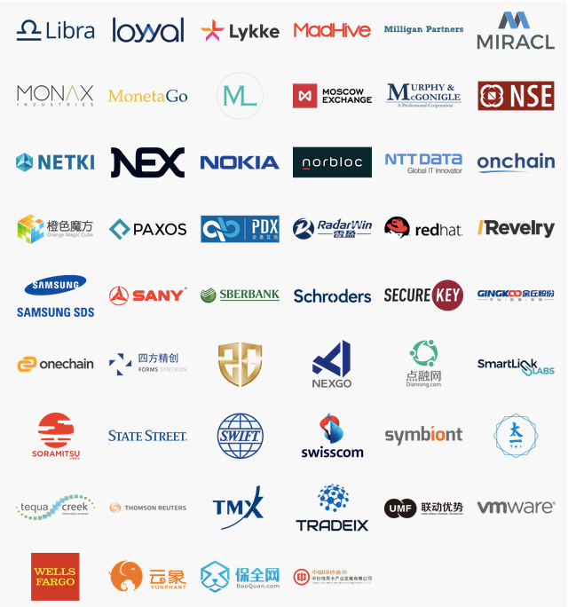
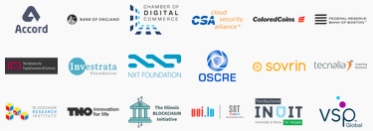
Hyperledger members
Premier
General
Source: https://www.hyperledger.org/about/members
Updated 21 August 2017
Associate
Notes:
Hyperledger is the fastest growing project in Linux Foundation history and has a huge amount of industry support.
These are the current set of members of the Hyperledger project. We update this slide very often, because the members grow quite quickly. Some really interesting ones. Again, you’d expect to see financial organizations in here, but to see organizations like Airbus, organizations like Daimler and other technology companies like Fujitsu and Attache, other services companies like Accenture, all of these really – I think it really shows that we’ve got a true cross-industry governance of the Fabric as it moves forward.
A number of other general members, a number of other associated members. Again, reinforcing this concept of actually having a very, very, very broad participation of –in this open governance process.

Slide 32
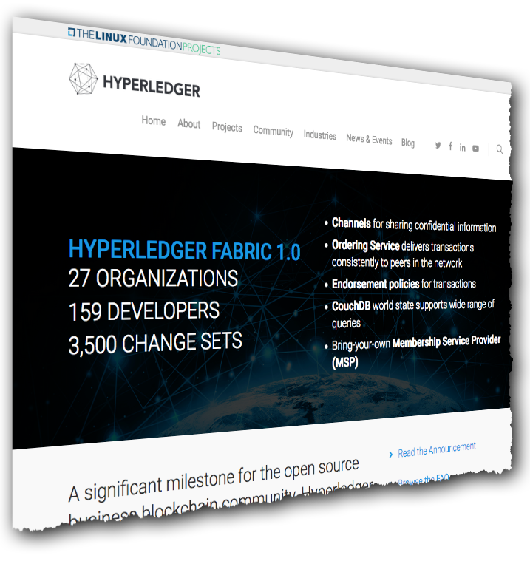
Hyperledger Fabric: Distributed ledger platform
An implementation of blockchain technology that is a foundation for developing blockchain applications
Emphasis on ledger, smart contracts, consensus, confidentiality, resiliency and scalability.
V1.0 released July 2017
159 developers from 27 organizations
IBM is one contributor of code, IP and development effort to Hyperledger Fabric
http://hyperledger-fabric.readthedocs.io/
Notes:
Hyperledger Fabric is one of two Hyperledger projects that IBM is significantly investing in, although it is important to note that Fabric is NOT an IBM project. V1 was released on 11 July 2017 with developers representing 27 different organizations. See https://www.hyperledger.org/blog/2017/07/11/hyperledger-fabric-1-0-is-released.

Slide 33
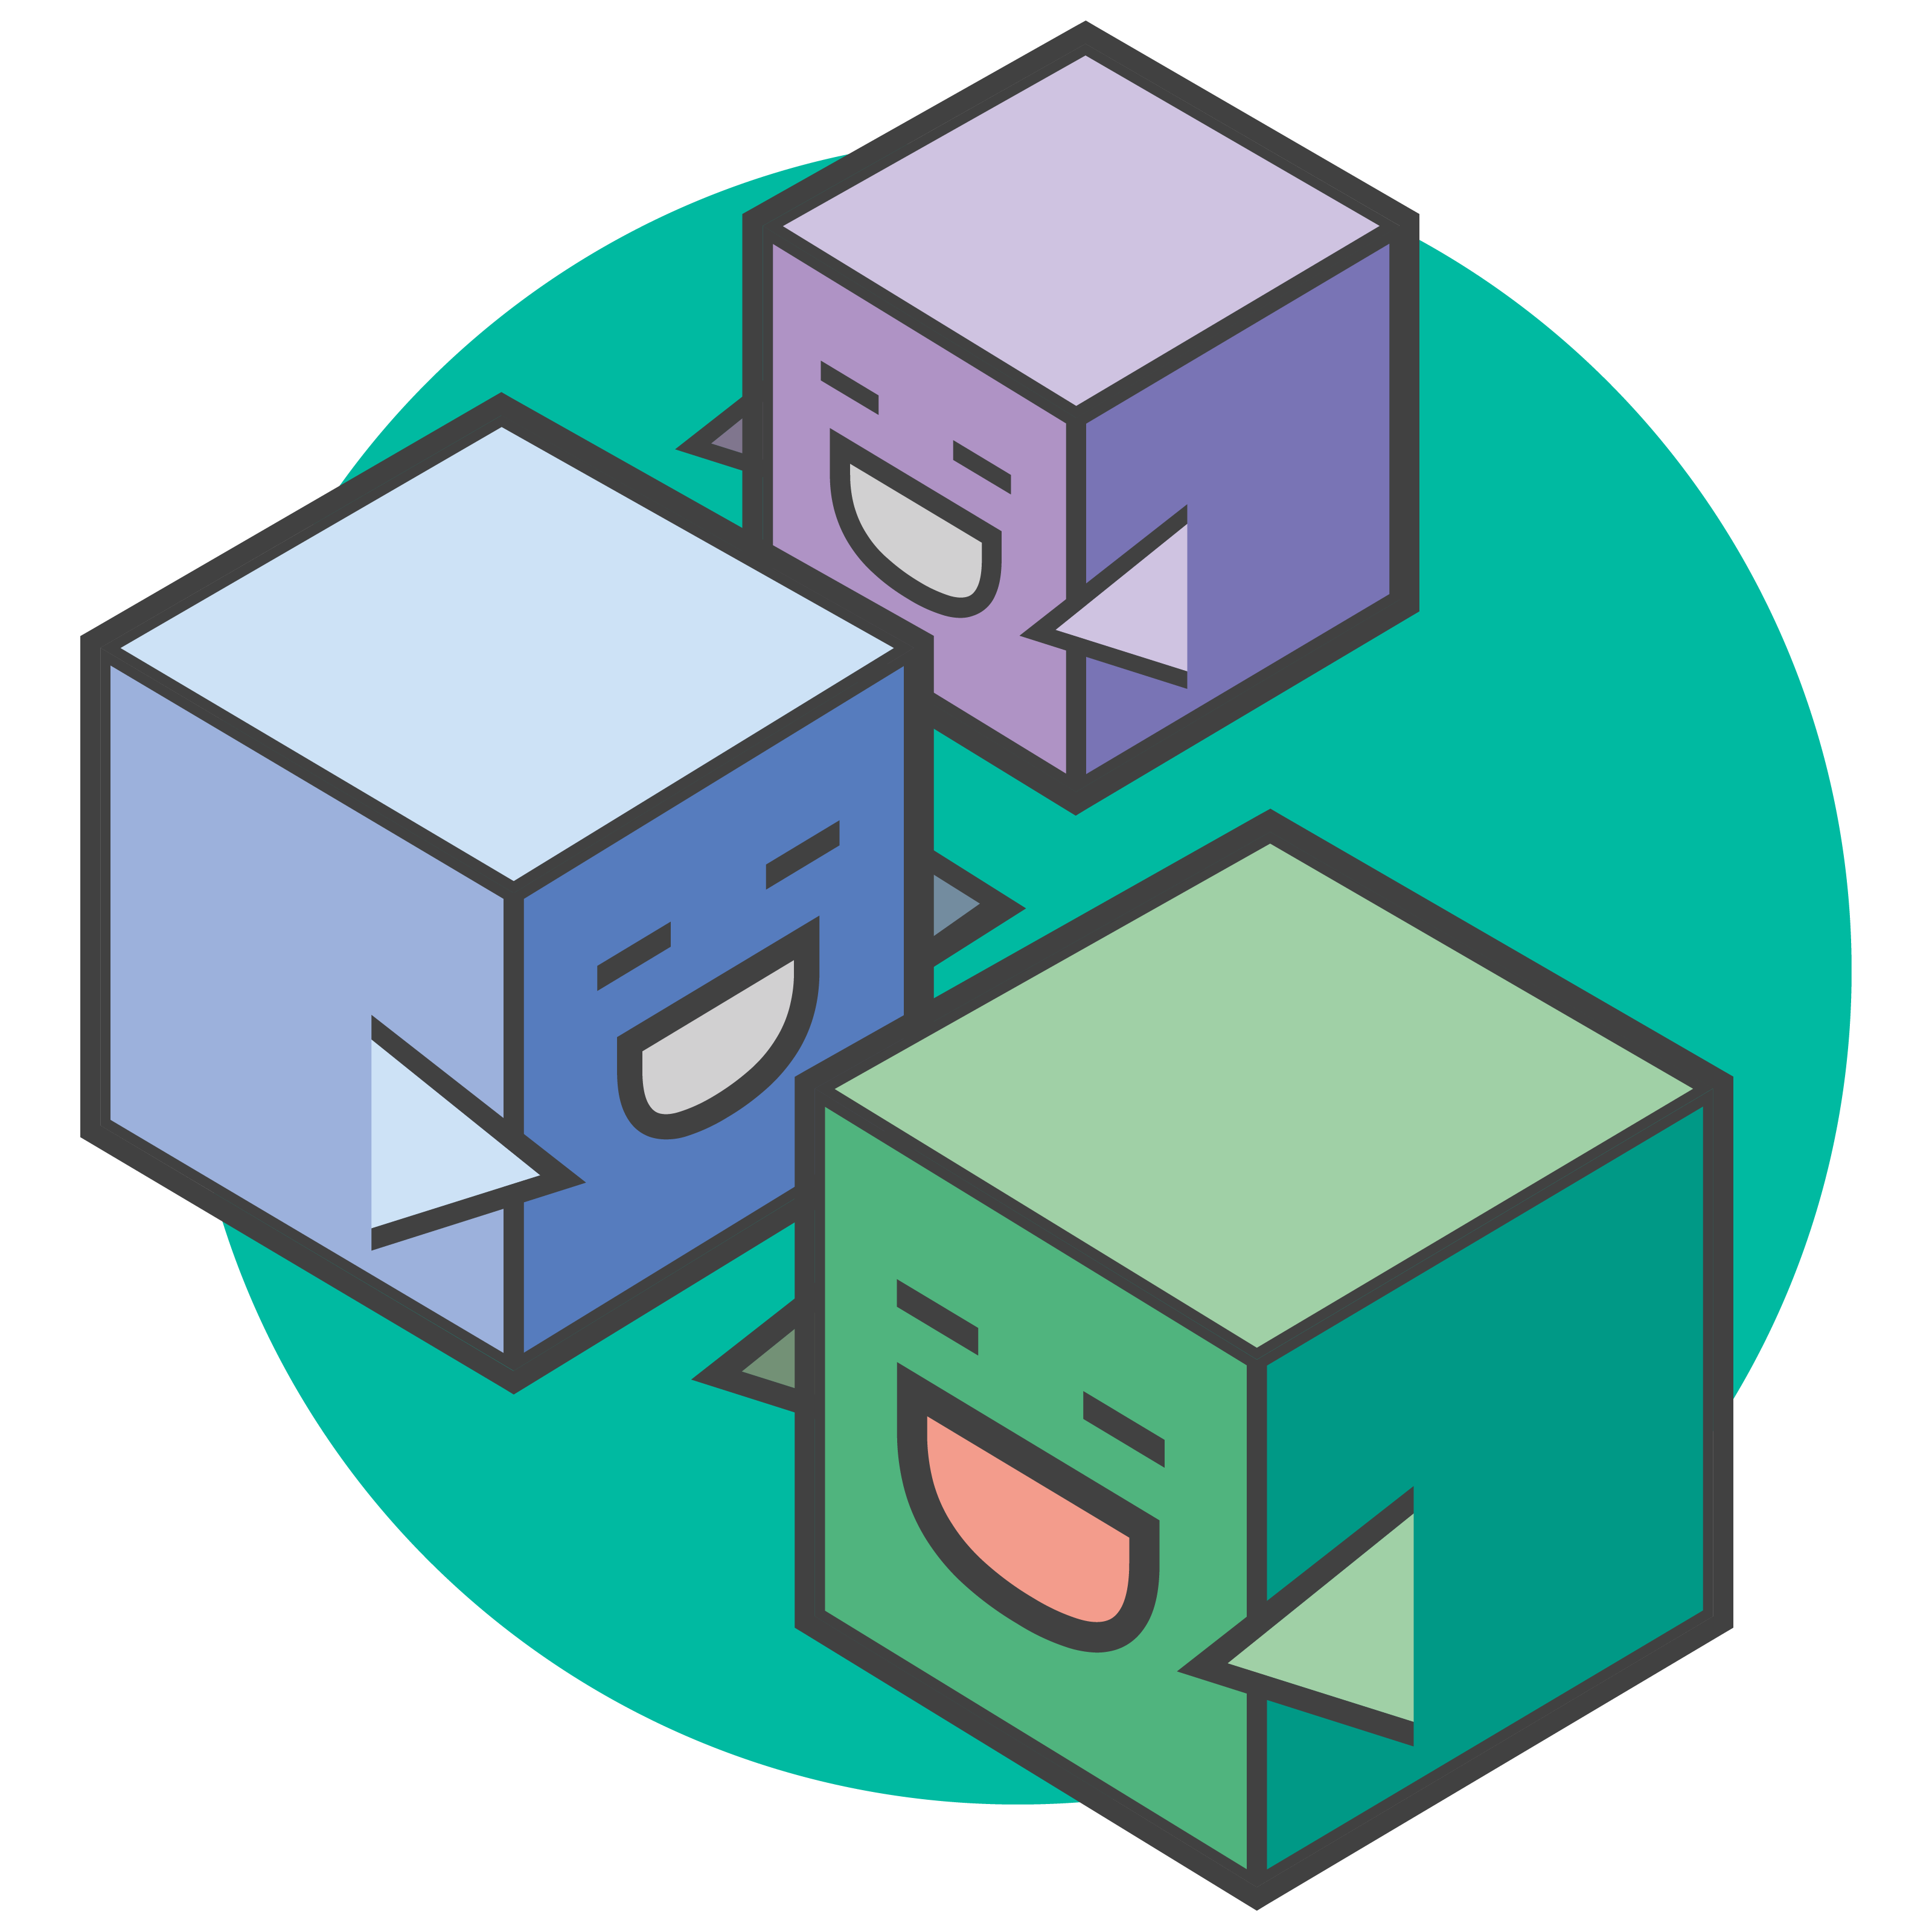
Hyperledger Composer: Accelerating Time to Value
Business Application
https://hyperledger.github.io/composer/
A suite of high level application abstractions for business networks
Emphasis on business-centric vocabulary for quick solution creation
Reduce risk, and increase understanding and flexibility
Hyperledger Composer
Blockchain (Hyperledger Fabric)
Features
Model your business networks, test and expose via APIs
Applications invoke transactions to interact with business network
Integrate existing systems of record
Fully open and part of Linux Foundation Hyperledger
Try it in your web browser now: http://composer-playground.mybluemix.net/
Notes:
Hyperledger Composer aims to bridge the gap between the high level abstractions that have been described in this presentation (i.e. assets, participants and transactions) and the technical realities of Hyperledger Fabric (i.e. invoking code on a distributed processing system).
By exposing a domain specific language and transaction processor functions in Javascript, the effect of Composer is that it allows you to develop blockchain applications very quickly. It saves time and increases flexibility.
Hyperledger Composer is now a Linux Foundation Hyperledger project. It requires Hyperledger Fabric.

Slide 34



Introducing the IBM Blockchain Platform
Develop Explore and accelerate development time with tools that ensure close alignment between business leaders and developers
Govern Speed activation, customization and management of your business network with democratic, multi-party governance tooling
Operate Deploy and operate always-on networks with production-ready enterprise performance and security for most demanding use cases
The only fully integrated enterprise-ready blockchain platform designed to accelerate the development, governance, and operation of a multi-institution business network
Based on Hyperledger Fabric V1 runtime optimized for enterprise requirements
Specialized compute for security, performance and resilience
Delivered via the IBM Cloud on a global footprint with 24x7 Integrated Support
Full lifecycle tooling to speed activation and management of your network
[http://ibm.biz/Platform_Demo]
© 2017 IBM Corporation
Notes:
While we’ve been actually taking an active role in this technology development, we’ve also been taking the technology that comes out of things like the Hyperledger project and hosting it on a number of different types of business networks. We’re hosting on this high-
security business network for customers who want to find a fast way of taking this into production, with assurety(?)and security to do that. We’re also hosting it on our IBM Bluemix network. So this allows customers to do experimentation very quickly and efficiently, as does the containerization of the Blockchain Fabric, which again, supports rapid experimentation with Blockchain.
So effectively, we support the whole spectrum, from early experimentation, low friction experimentation, all the way through production usage of the Blockchain technology. And we’re also working to make Blockchain real for our customers.
And the concept here is to come up with some quite straightforward, obvious processes, to allow customers to work with us to really find out which parts of their business couldbe transformed using Blockchain and then work with us to effectively implement those improvements.
Rapidly activate your blockchain network in 1/3 the time:
With tools that help you overcome the difficult collaboration and technical tasks you will run into as you move from ideas to production
Experience of over 400 client engagements at your fingertips with numerous tools to accelerate the heavy lifting required to make your blockchain network a reality
The IBM Blockchain Platform is the only integrated, business ready platform that addresses the full life cycle (develop, govern, and operate) of a multi-organization blockchain network.
Designed to accelerate through phased collaboration the creation of a “built for business” global blockchain network across industries and use cases
In record time, you can:
Collaborate to build your code with team based DevOps leveraging Hyperledger Fabric and Hyperledger Composer
Invite and manage your ecosystem with democratic business rules
Keep the network running in a hyper-secure environment that meets the performance and trust requirements of even the most demanding and regulated industries

Slide 35

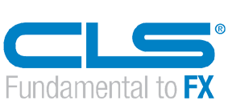
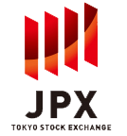
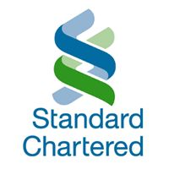


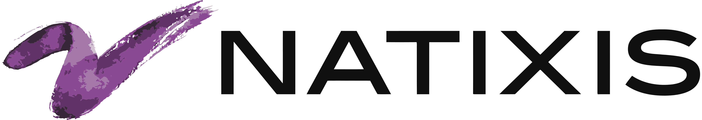
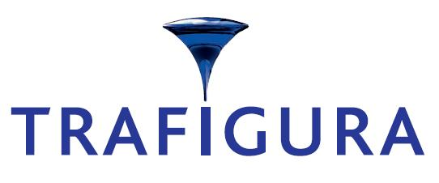
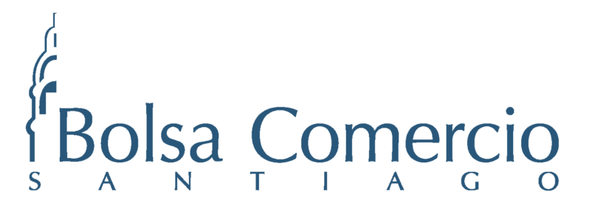


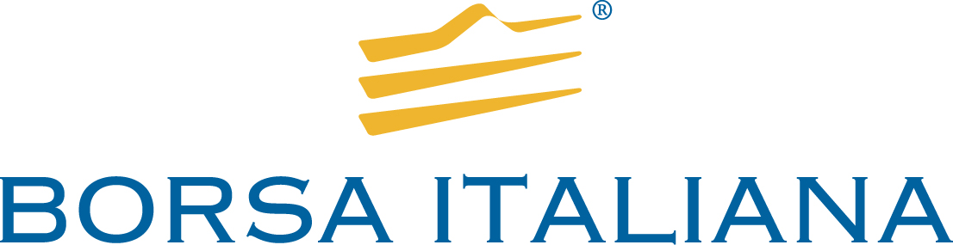
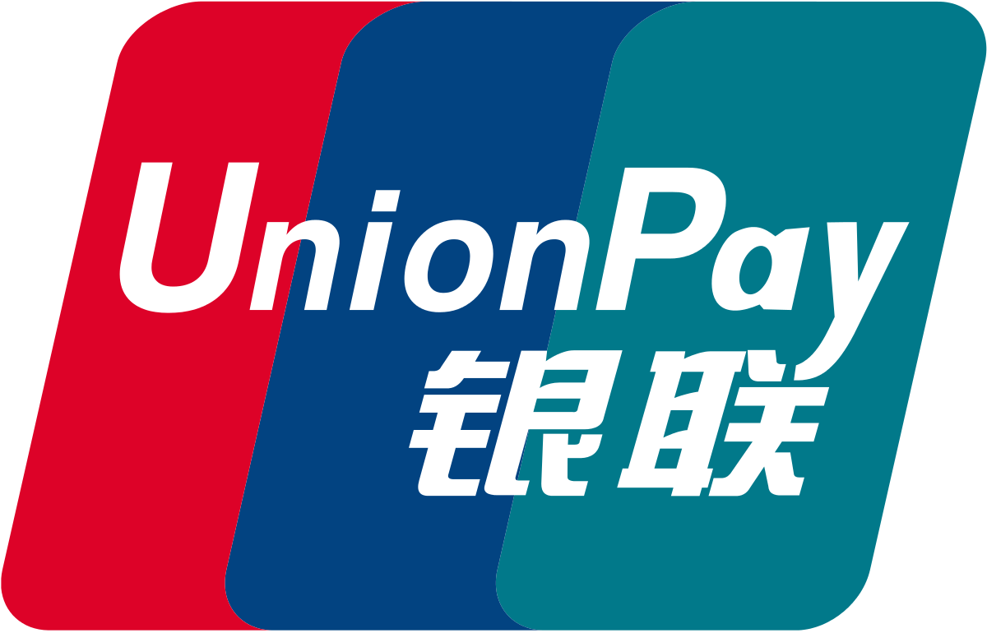
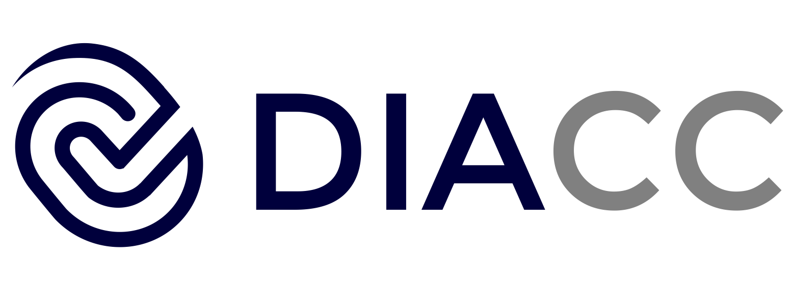


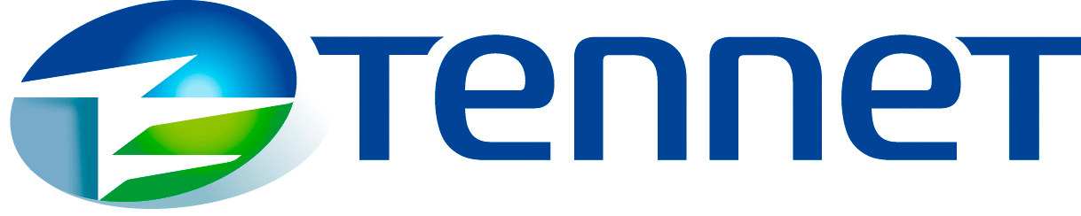
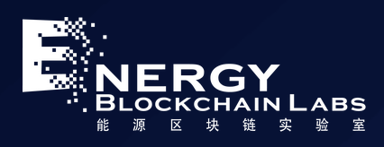
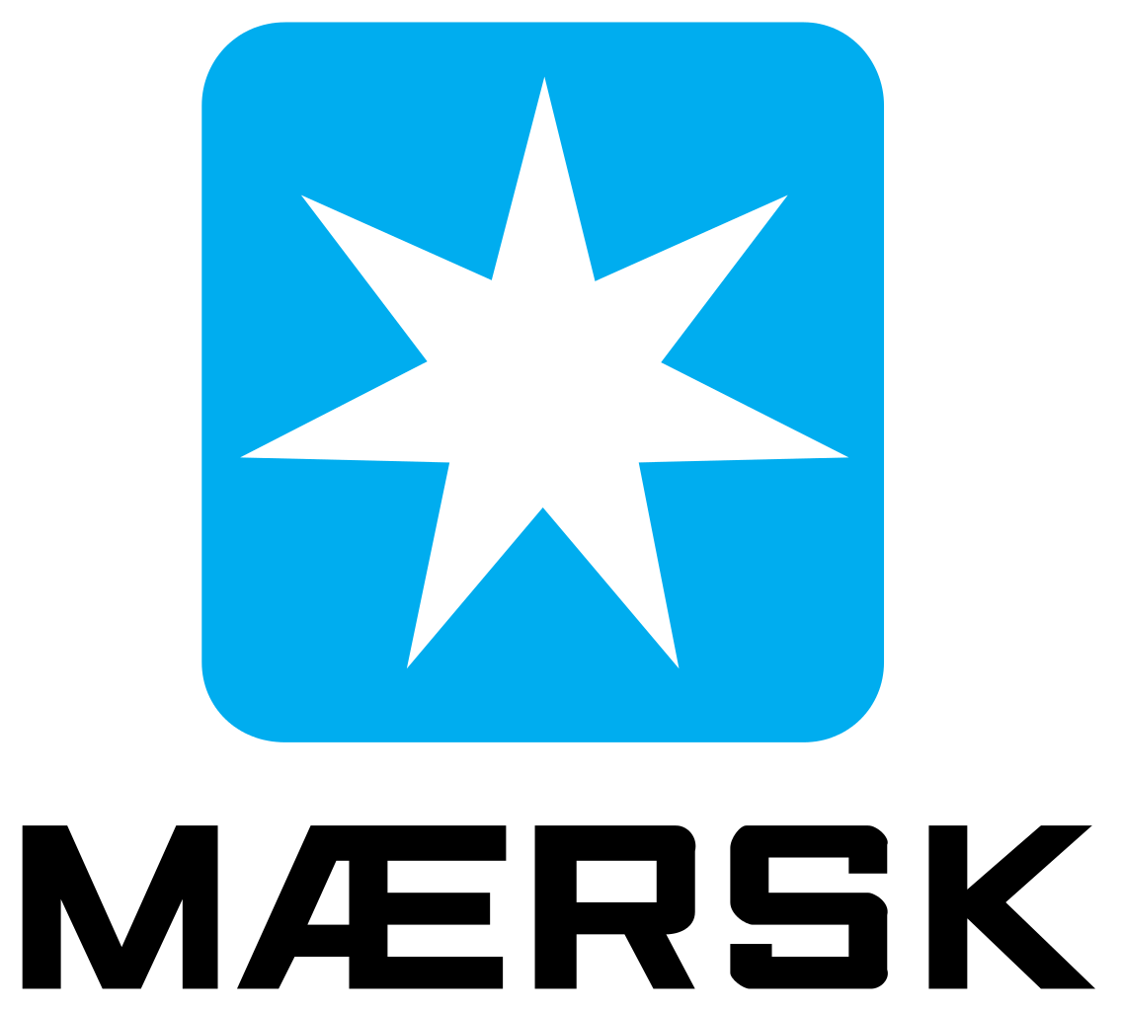
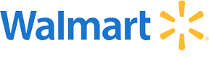
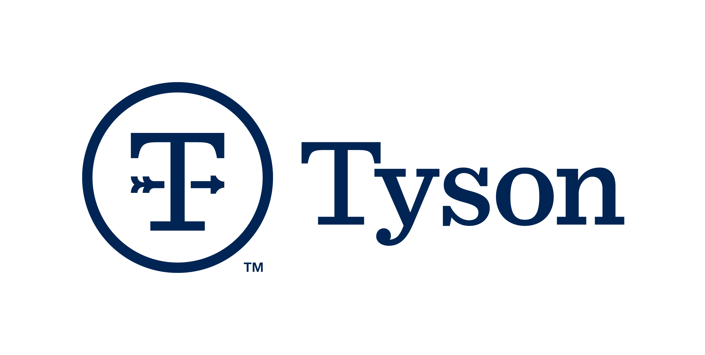
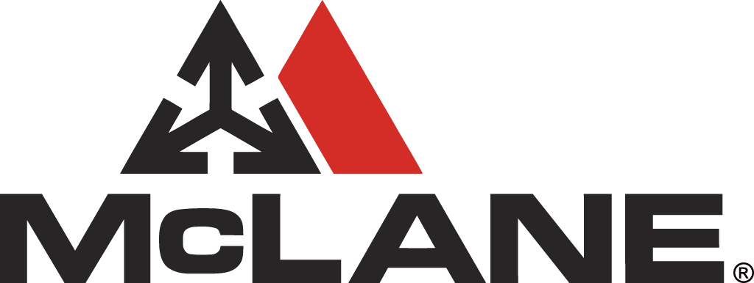

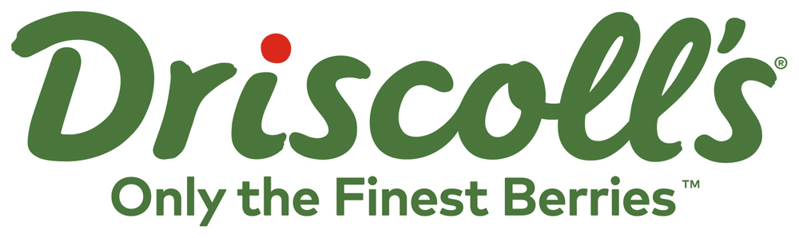
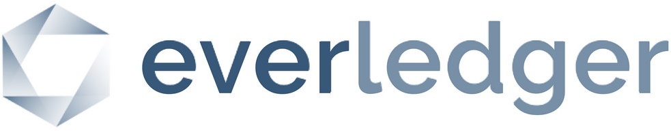

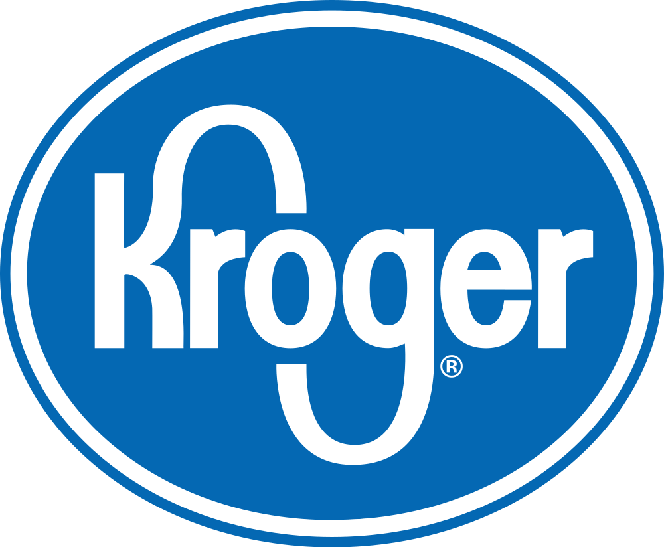
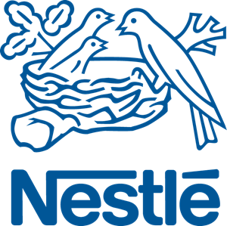

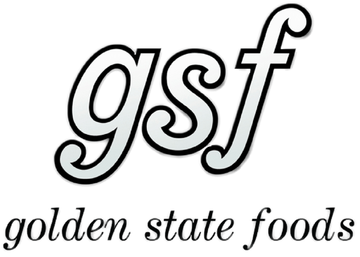
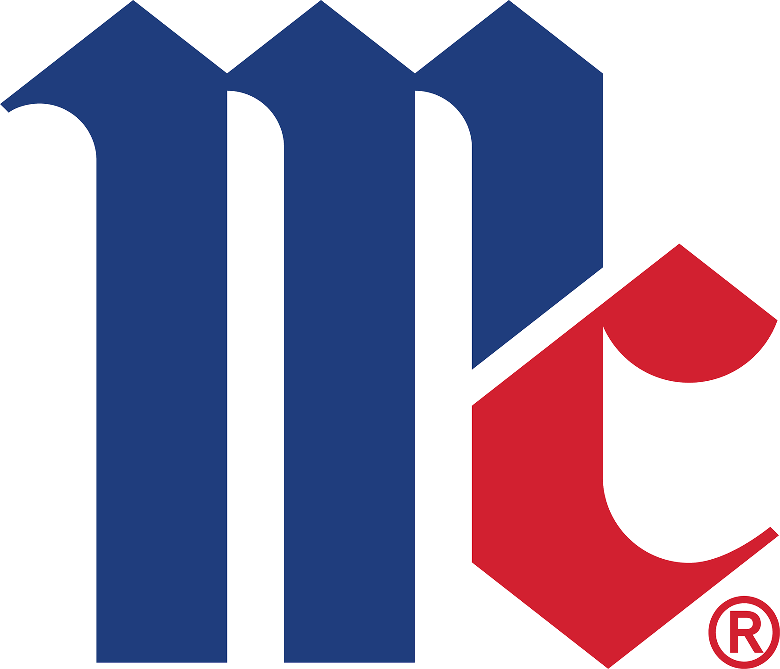
Making blockchain real for business with over 400 engagements and multiple active networks
Trade Finance | Pre and Post Trade | Complex Risk Coverage
Identity/ Know your customer (KYC) | Unlisted Securities/ Private Equity Funds | Loyalty Program
Medicated Health Data Exchange | Fraud/ Compliance Registry | Distributed Energy/ Carbon Credit
Supply Chain | Food Safety | Provenance/ Traceability
Notes:
IBM brings the experience of over 400+ Client engagements and multiple active networks at your ecosystems fingertips.
The IBM Blockchain Platform puts the experience of over 400+ Client engagements and multiple active networks at your ecosystems fingertips.
IBM has a large and increasing number of public references on blockchain.
COMPLETE LIST with references is here > http://ibm.biz/BlockPubRef
Northern Trust:
http://www-03.ibm.com/press/us/en/pressrelease/51655.wss
Maersk:
http://www-03.ibm.com/press/us/en/pressrelease/51712.wss
HSBC, Bank of America, IDA:
http://www.coindesk.com/hsbc-bank-america-blockchain-supply-chain/
ABN AMRO:
https://www.abnamro.com/en/newsroom/blogs/arjan-van-os/2016/walking-the-walk-exploring-the-power-of-blockchain.html
Crédit Mutuel Arkéa:
http://www.coindesk.com/ibm-completes-blockchain-trial-french-bank-credit-mutuel/
JPX:
http://www.ibm.com/press/us/en/pressrelease/49088.wss
Kouvola Innovation:
http://www.ibm.com/press/us/en/pressrelease/49029.wss
London Stock Exchange:
http://www.ibtimes.co.uk/linux-foundation-blockchain-consortium-digital-asset-ibm-credits-london-stock-exchange-board-1533798
Mizuho:
http://www.coindesk.com/mizuho-digital-currency-powered-blockchain-settlement/
IBM Global Finance:
http://www.coindesk.com/ibm-building-blockchain-dispute-resolution-system/
Everledger
https://www-03.ibm.com/press/us/en/pressrelease/50169.wss
Bank of Tokyo Mitsubishi
https://www-03.ibm.com/press/us/en/pressrelease/50544.wss
China UnionPay
http://www.coindesk.com/ibm-china-unionpay-blockchain-loyalty-exchange/
CLS
http://www.coindesk.com/cls-to-develop-blockchain-payment-service-on-ibm-fabric/
UBS
http://www.coindesk.com/ubs-blockchain-prototype-trade/
IBM GF: http://www.coindesk.com/ibm-building-blockchain-dispute-resolution-system/

Slide 36
IBM Engagement Model overview
Let’s Talk
Blockchain
Hands-on
First Project
Scale
Discuss Blockchain technology Explore customer business model Show Blockchain Application demo | Understand Blockchain concepts & elements Hands on with Blockchain Standard demo customization | Design Thinking workshop to define/refine business challenge Agile iterations incrementally build project functionality Enterprise integration | Scale up pilot or Scale out to new projects Business Process Re-engineering Systems Integration
Remote | Digital | Face to face | Face to face
Notes:
As of end-2016, IBM has over 400 clients going through this pipeline (public information).
Blockchain Hands-on is analogous to a proof-of-technology, but is designed for business people in addition to technical people.
First project is analogous to a proof-of-concept, but is designed to provide real and ongoing value to the client rather than being disposable.
We do not recommend short-cutting any stage in this process.

Slide 37




Getting started on your blockchain journey
Learn More About IBM Blockchain | Schedule an IBM Blockchain Workshop
Develop a Blockchain Application | Activate and Grow your Blockchain Network
Notes:
As of end-2016, IBM has over 400 clients going through this pipeline (public information).
Blockchain Hands-on is analogous to a proof-of-technology, but is designed for business people in addition to technical people.
First project is analogous to a proof-of-concept, but is designed to provide real and ongoing value to the client rather than being disposable.
We do not recommend short-cutting any stage in this process.

Slide 38
Thank You
Jin VanStee
jinxiong@us.ibm.cm
Barry Silliman
silliman@us.ibm.com
Austin Grice
austin.grice@ibm.com
Dave Wakeman
dwakeman@us.ibm.com
Daniel Acosta
acostad@us.ibm.com

Slide 40
Introducing IMMUNIchain
Designed by Suzie Wendler, Guy Shevik, Mark Rader and Mike Bonett from the IBM Washington Systems Center, won an internal Blockchain Hackathon
The challenge
A child's immunization record is one that:
Is updated and maintained (annually) by only medical providers
Is kept by guardians who ensure that the child is immunized
Conforms to the requirements defined by the CDC/state/school district
Is requested/required by:
Schools on an annual basis
Summer camps, athletic programs, etc.
Today, when requested, the record:
Must be current with the most recent updates
Is usually provided as a paper printout
Is mailed/delivered/faxed to different organizations throughout the year (could be multiple times)
Notes:
When needed, it is transferred between providers
Different states have different requirements

Slide 41
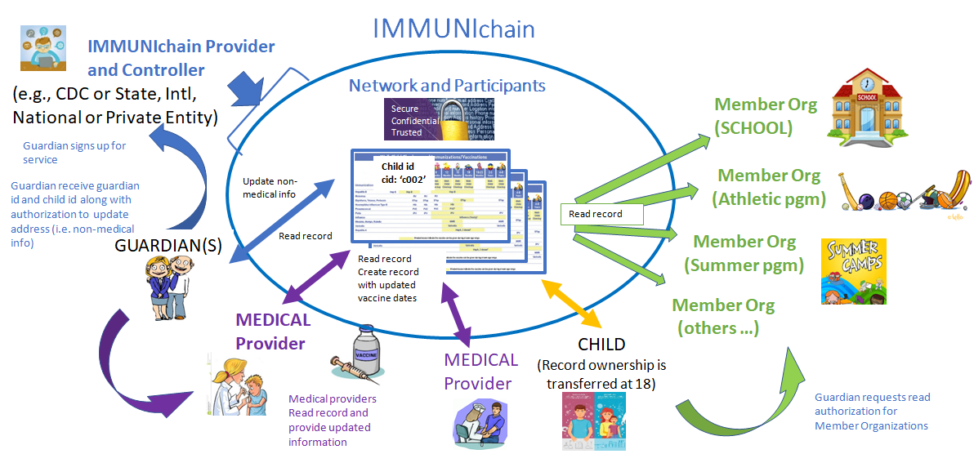
The Solution - Streamlined, Fast, Secure
A blockchain allowing doctors/medical practitioners to provide updated records of the child's immunizations. Guardians may authorize service providers (member) to view the record.

Slide 42
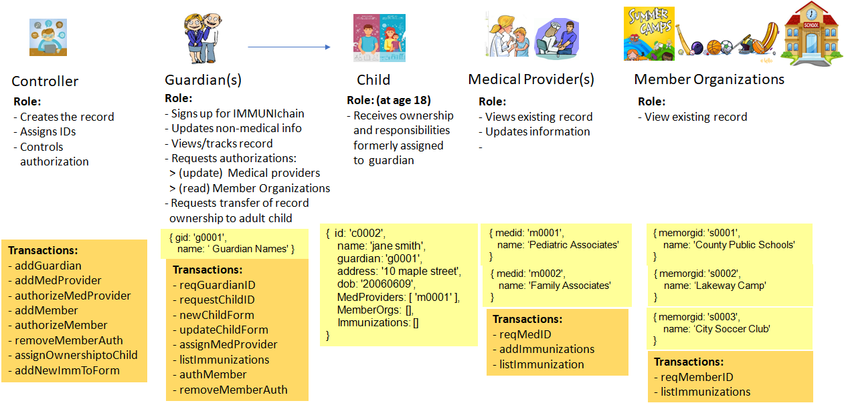
Participants, Roles, and Transactions

Slide 43
Lab Prereqs
Day 2 Agenda
Blockchain Composed
Composer Lab using IMMUNIChain
Download files related to the lab from:
https://github.com/grice32/immunichain
Get the Chrome browser

